Slide 1
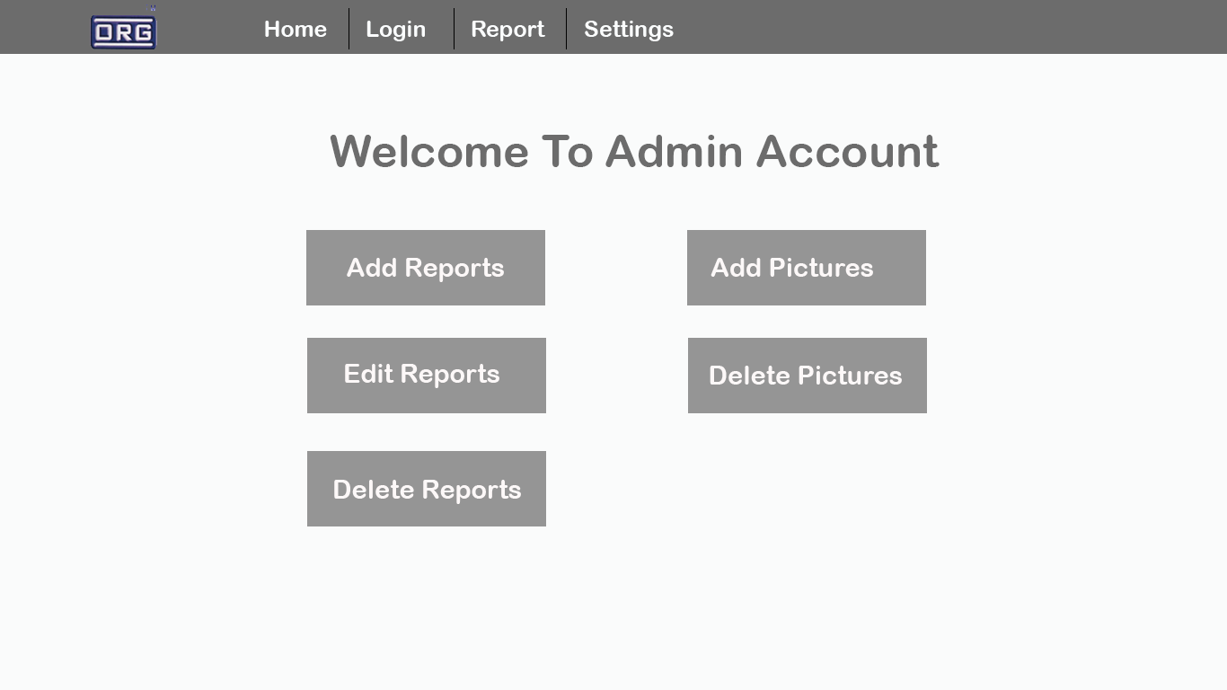
Put it as Harbauer
Include Export report option
Remove delete report option

Slide 2
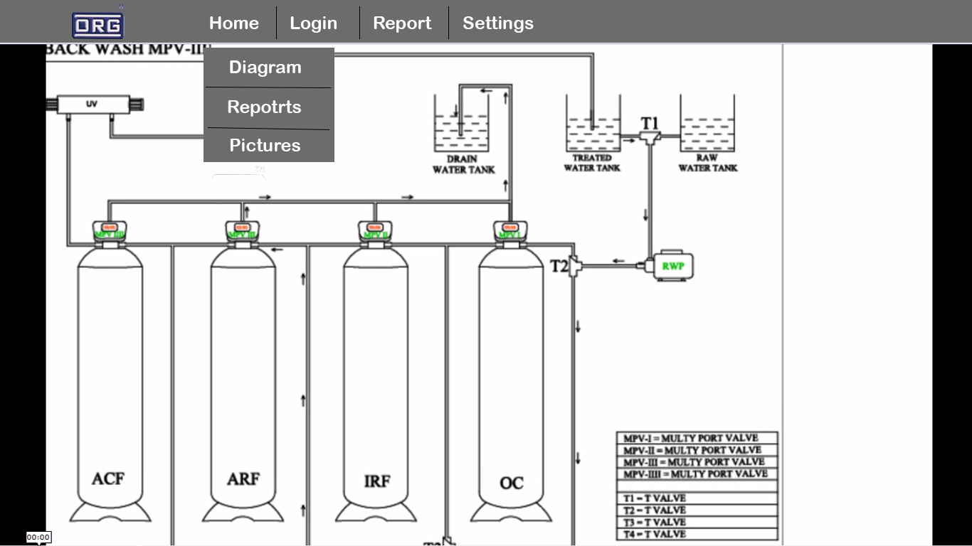
Rename this to “Soak Pit”
Please put the full names of the filters.
Activated Carbon Filter
Arsenic Removal Filter
Iron Removal Filter
Oxidation Chamber

Slide 3
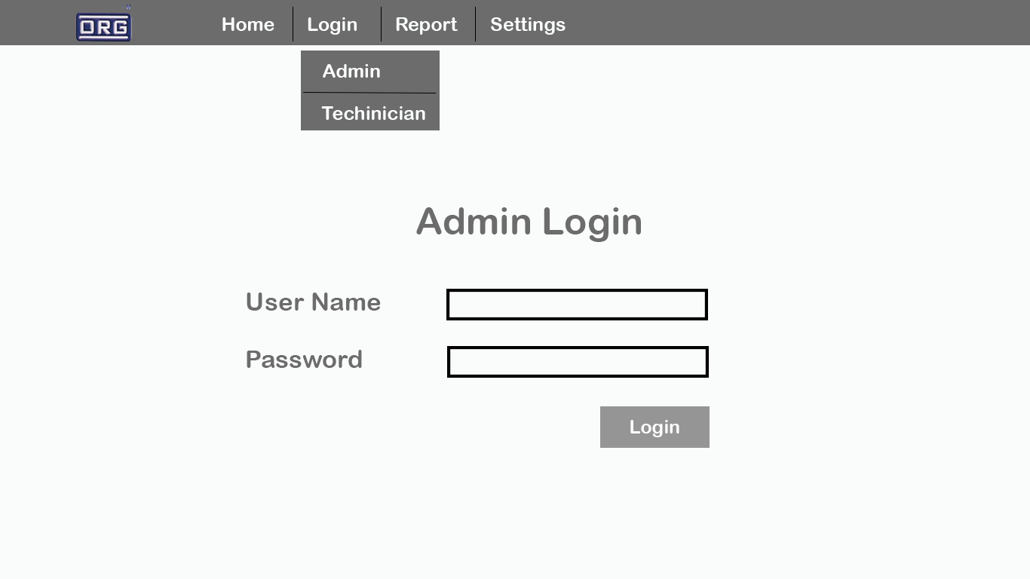
Spelling of “Technician”

Slide 4
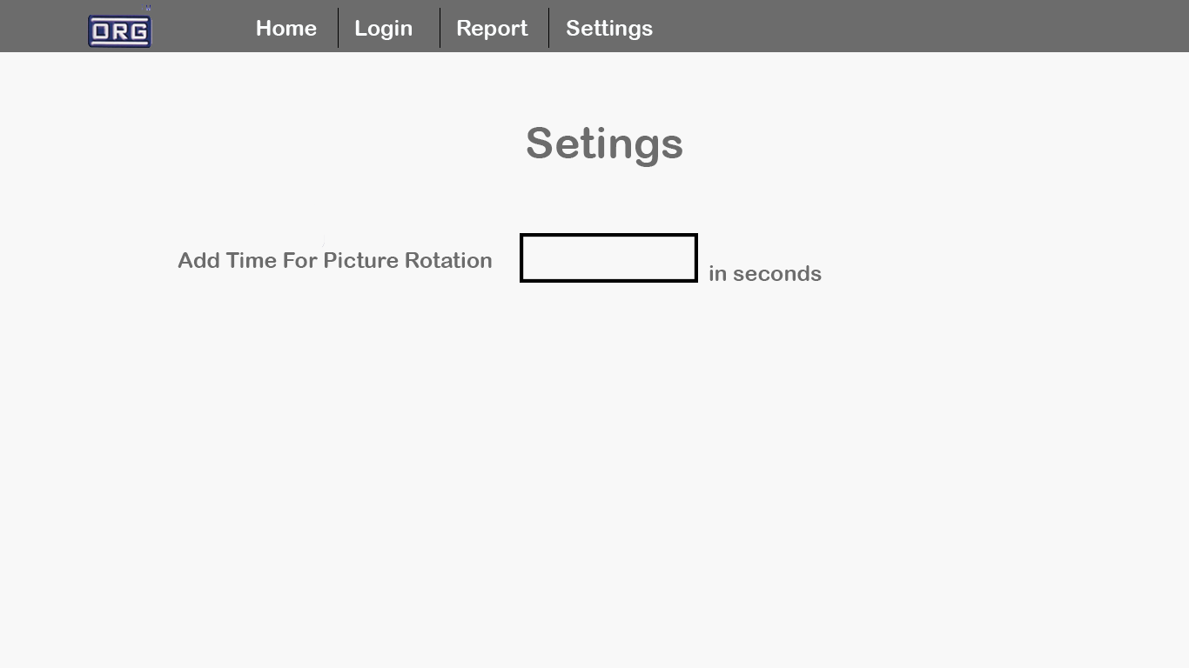
Spelling of “Settings”

Slide 5
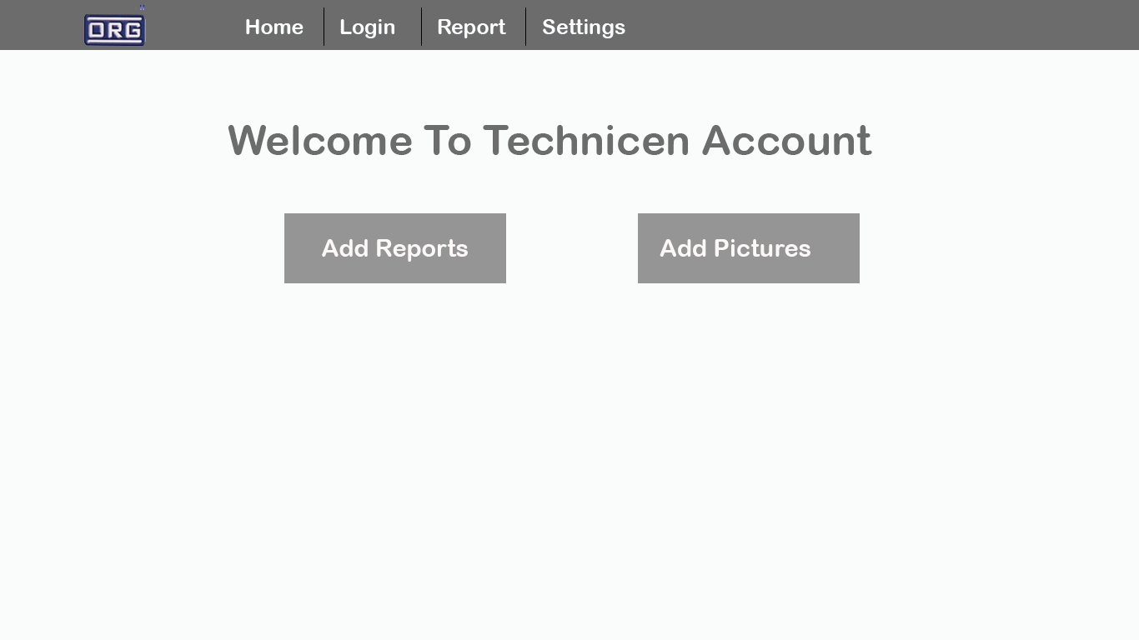
Spelling of “Technician”

Slide 6
Contamination | Raw Water Quality | Permissible Limits | Desirable Limits | Treated Water Quality
Arsenic (in mg/l) |  | 0.05 | 0.01
Iron (in mg/l) |  | 0.03 | 0.03
Bacteriological |  | Negative | Negative
As Per BIS 10500: 2012 (Second Revision)
Note for software developer:
Permissible Limits and Desirable Limits values cannot be edited.
Admin / Technician can only change the values of the Raw Water Quality and the Treated Water Quality

